Slide 1
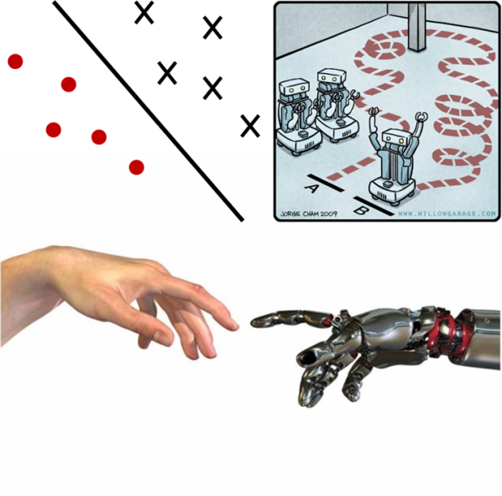

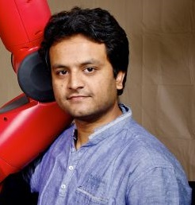
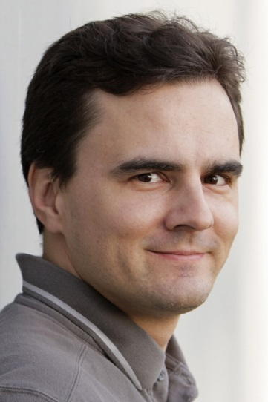
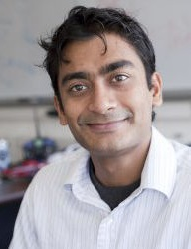
Learning Plans with Context from Human Signals
Drew Bagnell
CMU
Ashesh Jain
Cornell University
Jan Peters
TU Darmstadt
Ashutosh Saxena
Cornell University

Slide 2
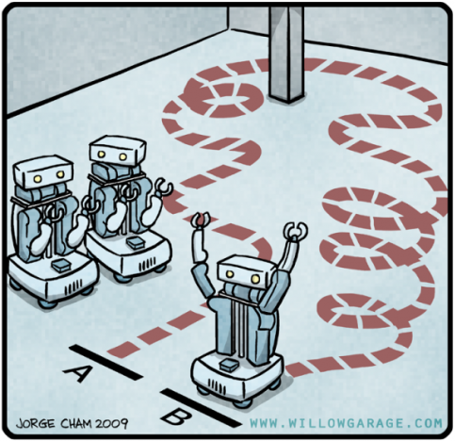
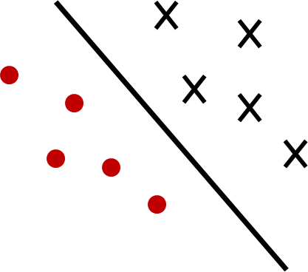
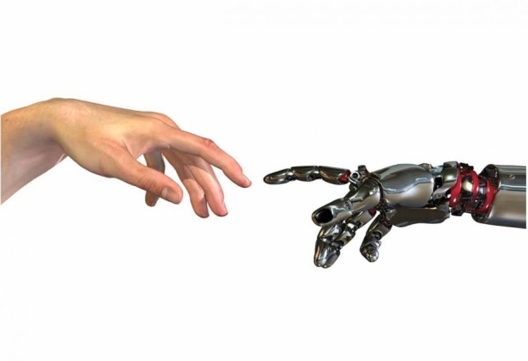
Learning Plans with Context from Human Signals
Planning
Assembly lines, homes, context-rich environments
Learning Algorithms
SVM, IRL, Graphical models,
No-regret algorithms
Human Signals
Expert’s demonstrations,
Co-active feedback, Language
Notes:
As planning problems becomes complex we relay on data driven leanring approaches. We receive human signals and have leanring algorithms.

Slide 3

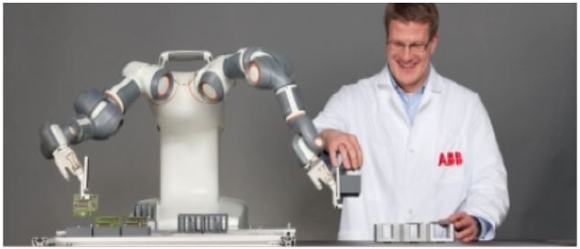
Multi-agent planning
Julie Shah
MIT
Planning for human-robot teams
Shared mental model
Shah’s lab, MIT
Notes:
Signals?
Algorithm?

Slide 4

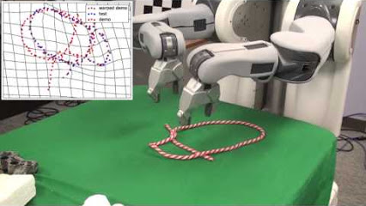
Task specific skills
Pieter Abbeel
UC Berkeley
Manipulating deformable objects
Knot tying
Abbeel’s lab, UC Berkeley
Notes:
This was the planning problem. This type to signal came in, and this is the algorithm they used.

Slide 5
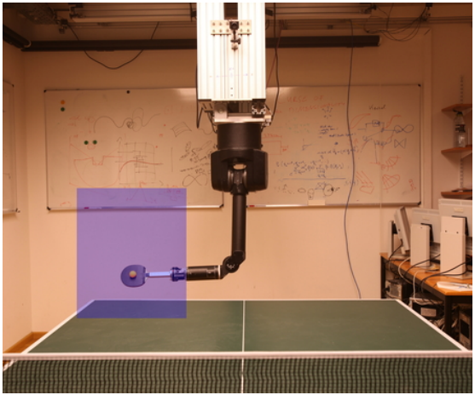
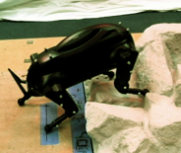
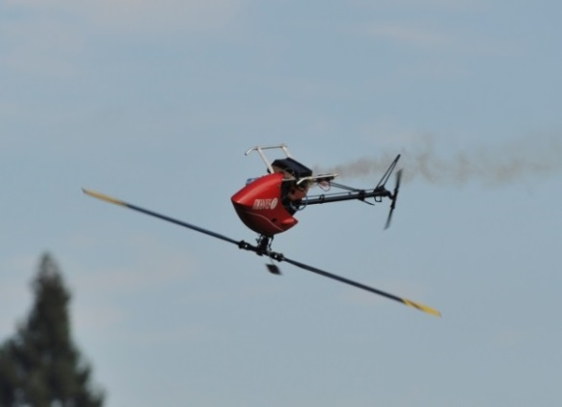
Learning from Expert’s Demonstration
Peters’ lab
Bagnell’s lab
Abbeel et al.

Slide 6
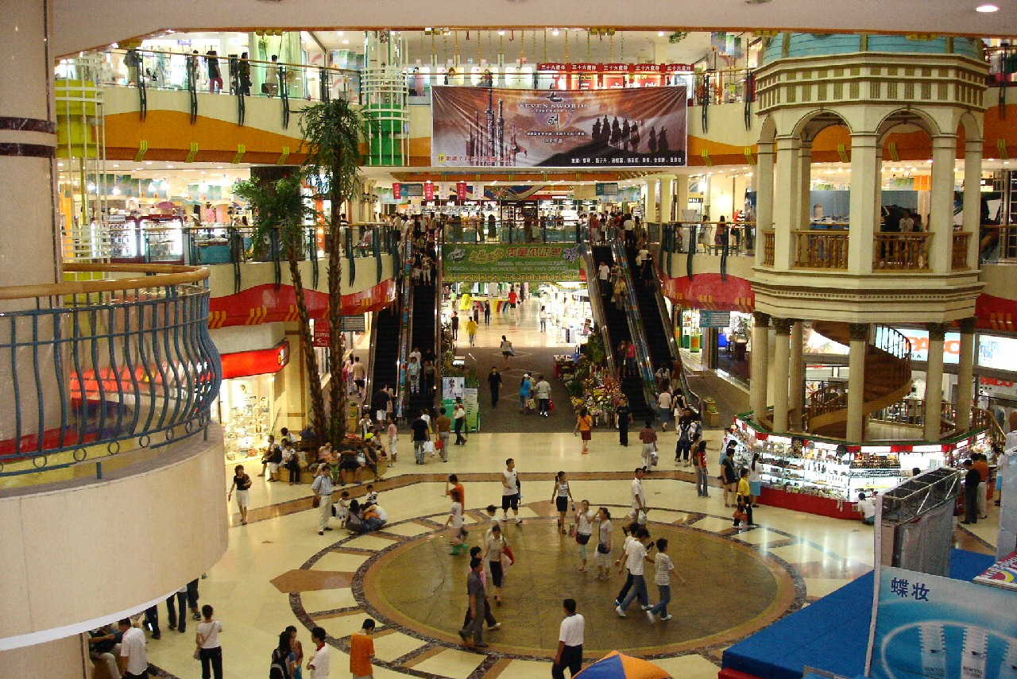
Real environments are more complex

Slide 7
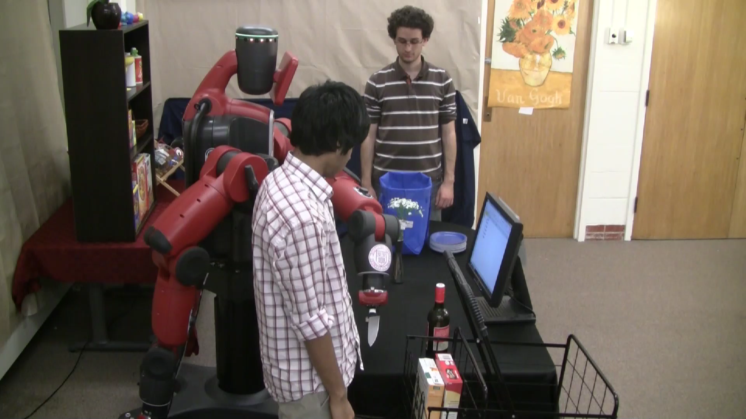
Planning in context-rich environments
Co-active feedback using object attributes
Jain et al., NIPS’13
Cornell Robot Learning Lab
Notes:
Signals?
Algorithm?

Slide 8
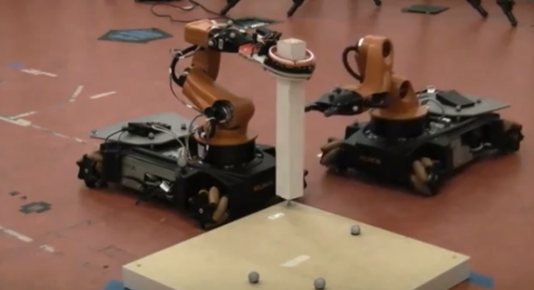
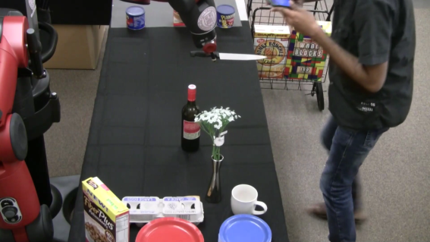

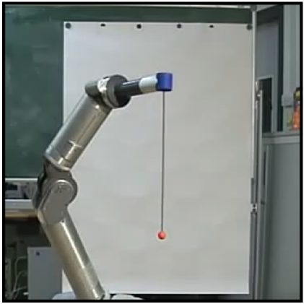
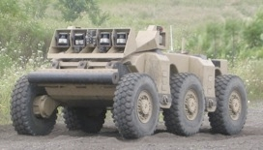
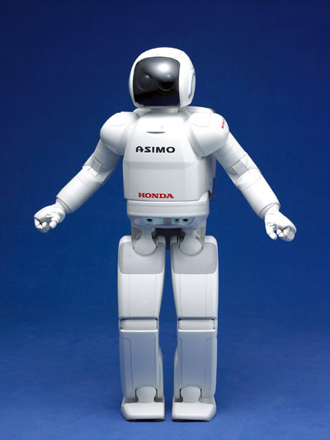
Planning problems

Slide 9
Learning Plans with Context from Human Signals
Planning
Assembly lines, homes, context-rich environments
Learning Algorithms
SVM, IRL, Graphical models,
No-regret algorithms
Human Signals
Expert’s demonstrations,
Co-active feedback, Language
Notes:
As planning problems becomes complex we relay on data driven leanring approaches. We receive human signals and have leanring algorithms.

Slide 10
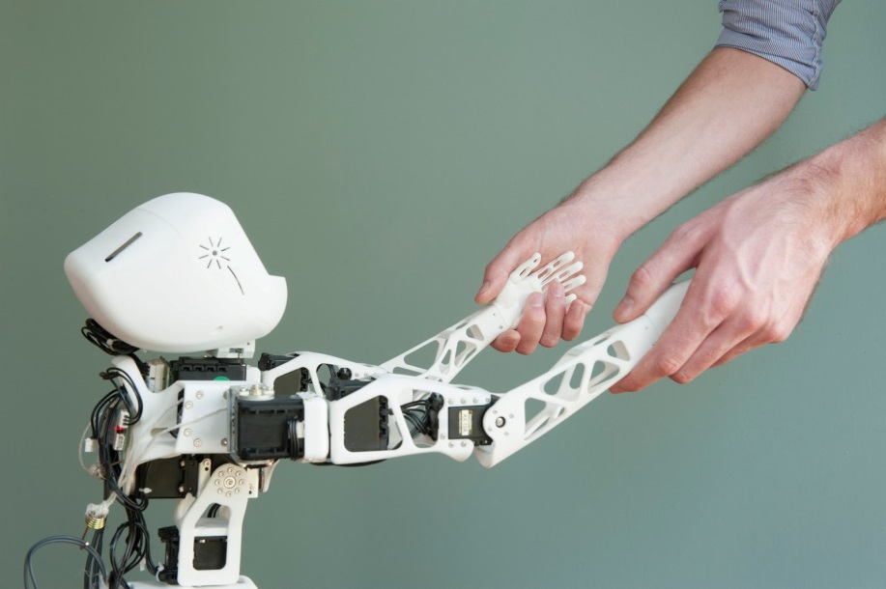
Rich human signals
Expert’s demonstrations
Inverse Reinforcement Learning
How do signals come in real-life?
?

Slide 11

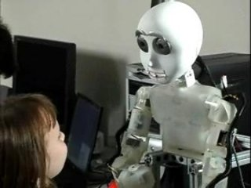
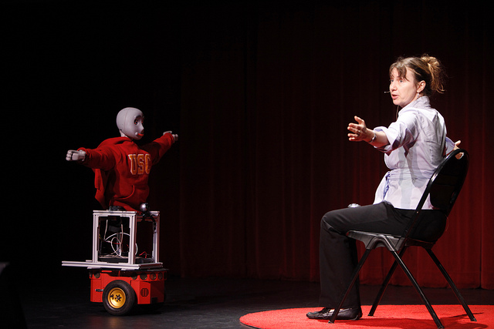
Rich human signals
Maja Mataric
USC
Expert’s demonstrations
Inverse Reinforcement Learning
How do signals come in real-life?
Socially assistive robots
Mataric’s lab, USC
Maja Mataric
Interaction Lab, USC

Slide 12

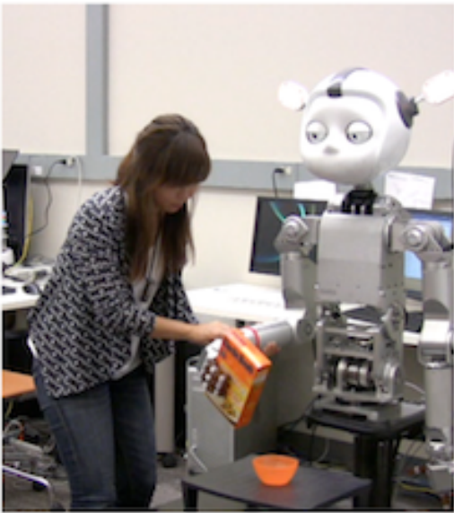
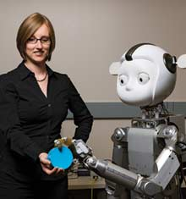
Rich human signals
Andrea Thomaz
GaTech
Expert’s demonstrations
Inverse Reinforcement Learning
How do signals come in real-life?
Asking questions
Thomaz’s lab, GaTech
Andrea Thomaz
Socially Intelligent Machines Lab, GaTech

Slide 13
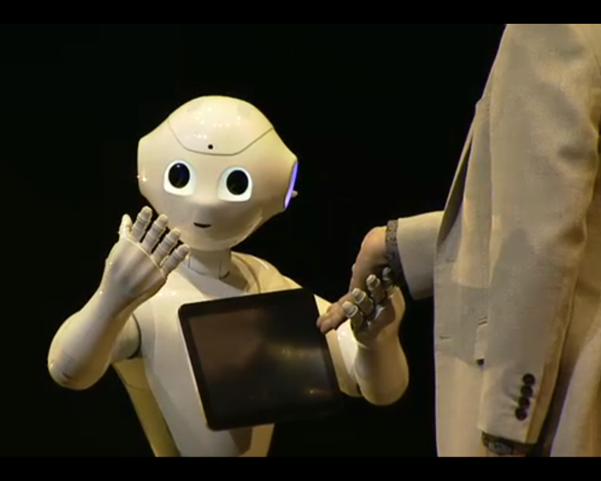
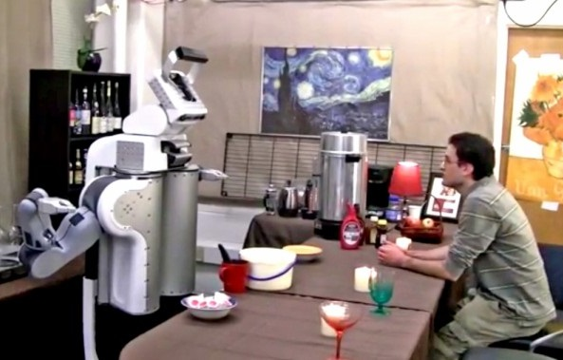
Rich human signals
Expert’s demonstrations
Inverse Reinforcement Learning
How do signals come in real-life?
Emotion signals
Pepper robot - SoftBank
Tell Me Dave (RSS’14)
Misra et al., Cornell Robot Learning Lab

Slide 14




Rich human signals
?
Natural language
Observing humans
Gestures and actions
Emotions
Asking questions

Slide 15
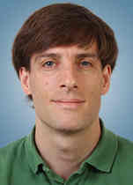

Learning algorithms
Demonstrations
Maximum Margin Planning (Ratliff et al.)
Maximum Entropy IRL (Ziebart et al.)
Feature counts matching (Abbeel et al.)
Key Frame based demonstrations (Akgun et al.)
Interactive Learning
Coactive Learning (Jain et al.)
Active IRL (Lopes et al.)
Trajectory Preference Queries (Wilson et al.)
DAGGER (Ross et al.)
Alan Fern
OSU
Manuel Lopes
INRIA
Crowdsourcing
Collaborative filtering for IRL (Burgard’s lab)
Natural language commands (Tellex et al.)
PlanIt (Jain & Saxena)
Tell Me Dave (Misra et al.)
Cornell Robot Learning Lab

Slide 16
Learning Plans with Context from Human Signals
Learning
from
Humans

Slide 17
Jain, Wojcik, Joachims, Saxena NIPS 2013
PlanIt: Learning Preferences from
Co-active Feedback

Slide 18
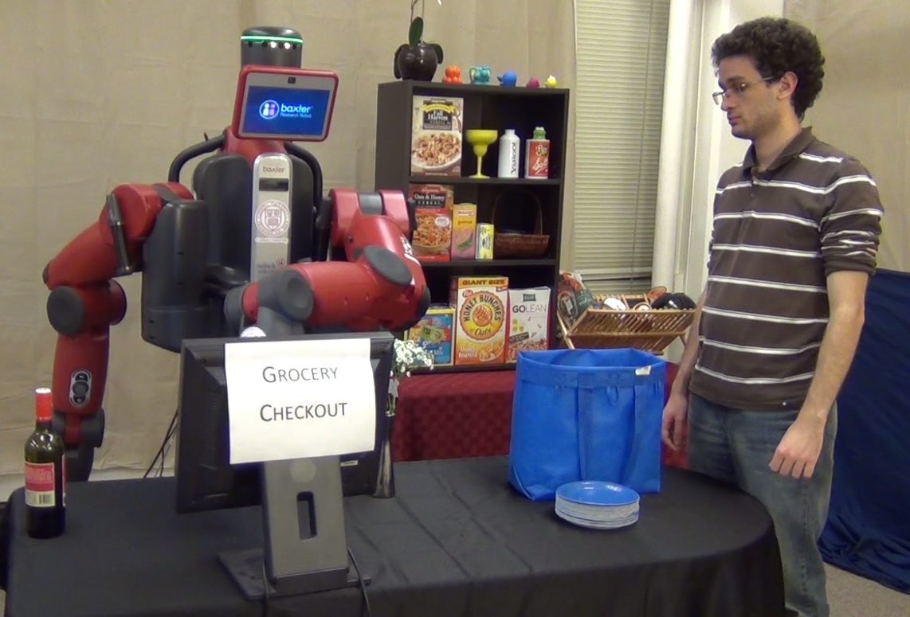
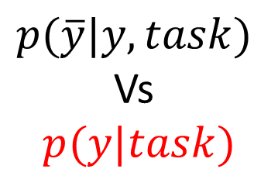
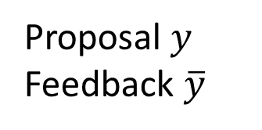
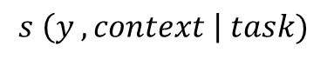
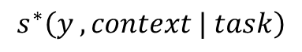

Co-active Learning Setting
$$s \left(y , context \right| task)$$
$$s^{∗}\left(y , context | task\right)$$
Robot
User
$p(\overline{y}|y,task)$
Vs
$$p(y|task)$$
Goal: Learn user preferences
Online learning system
Learns from user feedback
Sub-optimal feedback
Proposal $y$
Feedback $\overline{y}$
Jain et al. NIPS 2013
Cornell Robot Learning Lab

Slide 19
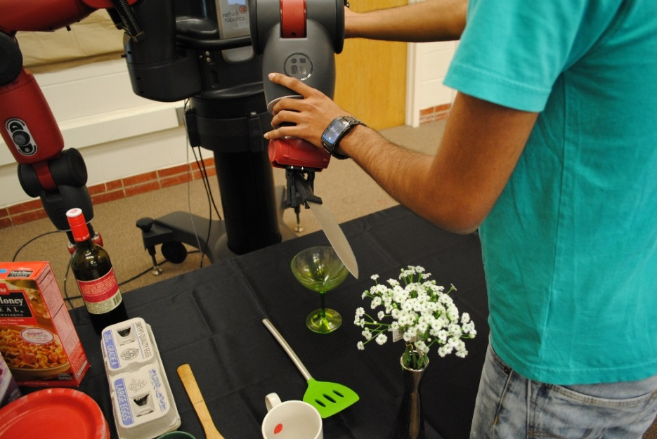

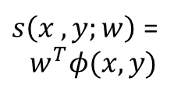
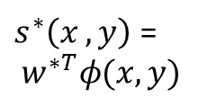
Co-active Learning Setting
$s\left(x , y;w\right)$ =
$$w^{T}φ(x,y)$$
$s^{∗}\left(x , y\right)$ =
$$w^{∗T}φ(x,y)$$
Robot
User
Goal: Learn user preferences
Learn from sub-optimal feedback
Jain et al. NIPS 2013

Slide 20
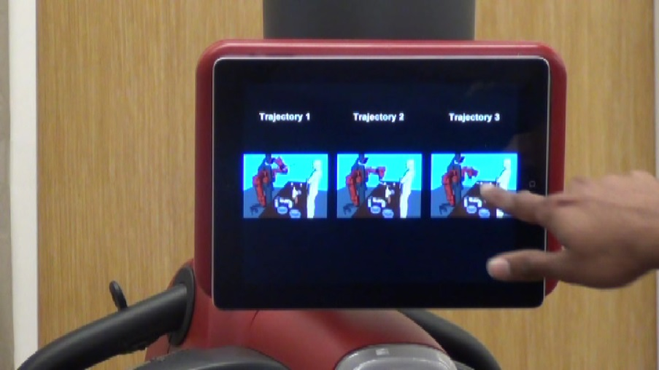
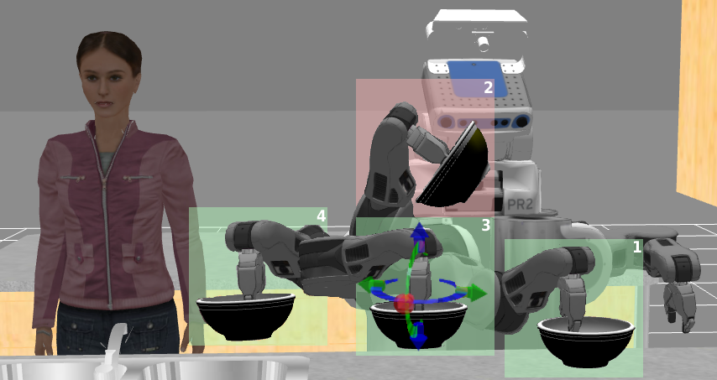
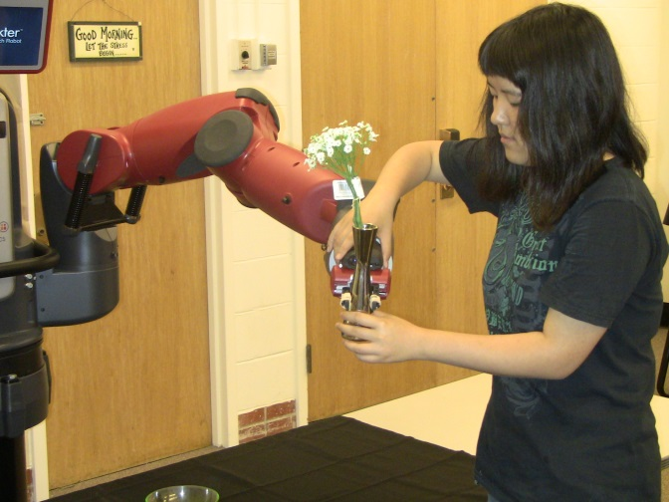
User Feedback
Intuitive feedback mechanisms.
Re-rank
Interactive
Zero-G
Notes:
In our setting we want the feedback to be really easy. So as feedback user slightly improve the trajectory proposed by the robot.

Slide 21
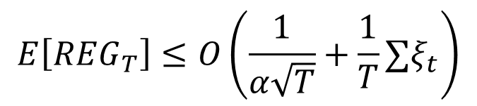
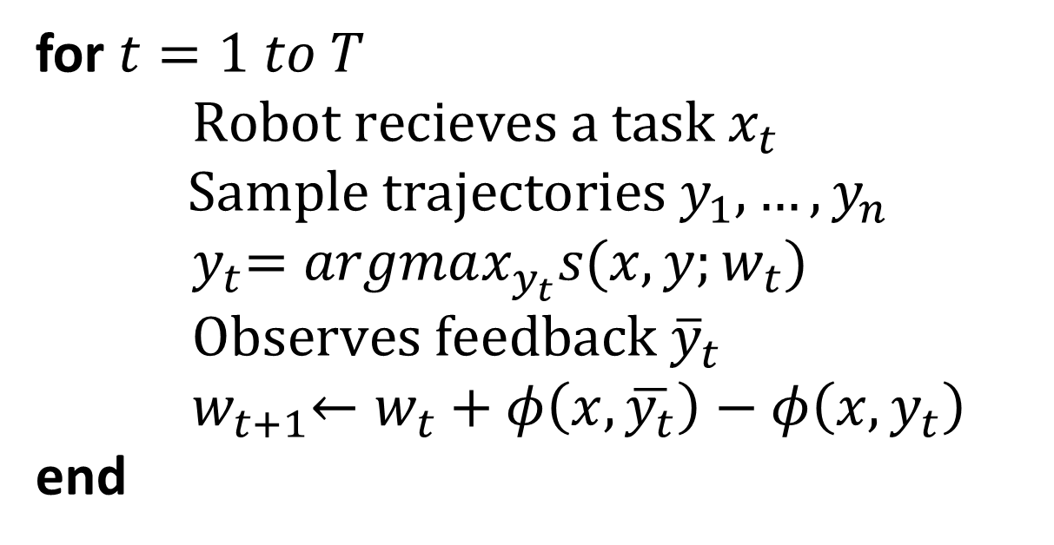
Co-active Preference Perceptron
for $t=1 to T$
$\text{Robot} \text{recieves} \text{a} \text{task} x_{t}$
$$\text{Sample} \text{trajectories} y_{1},…, y_{n}$$
${ y}_{t}=argmax_{y_{t}}s(x,y;w_{t})$
$\text{Observes} \text{feedback} {\overline{y}}_{t}$
${ w}_{t+1}←w_{t}+φ\left(x,\overline{y_{t}}\right)−φ\left(x,y_{t}\right)$
end
Regret bound
$$E\left[REG_{T}\right]≤O\left(\frac{1}{α\sqrt{T}}+\frac{1}{T}∑ξ_{t}\right)$$

Slide 22
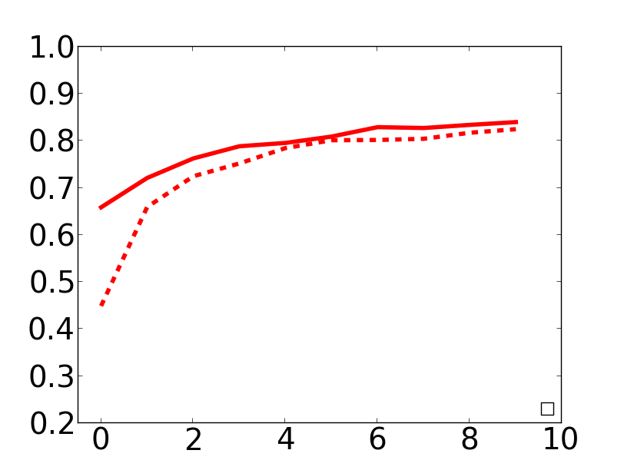
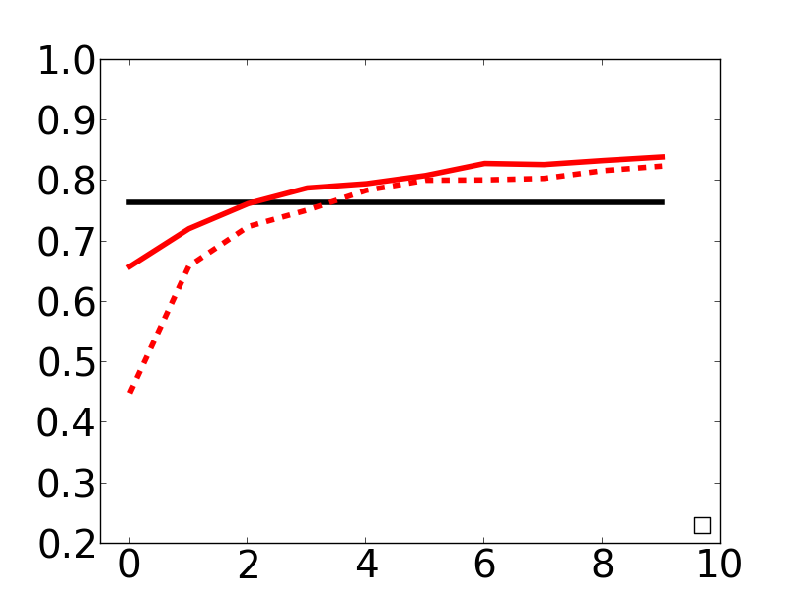
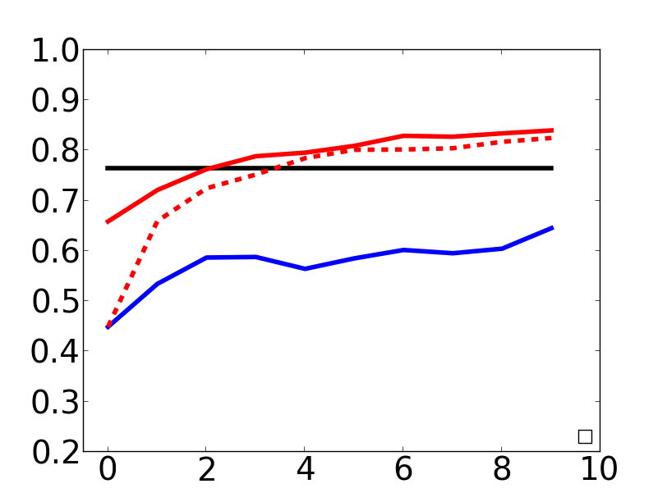
Generalization of Co-active perceptron
51 manipulation tasks
Moving, pouring, stirring, inserting etc.
20 different objects.
Testing on a new environment.
Ours pre-trained
nDCG@3
Expert
Ours w/o pre-training
MMP-online
(IRL)
#Feedback
Jain et al. NIPS 2013

Slide 23

Co-active feedback on Baxter

Slide 24
Scaling up human signals
Intuitive feedback mechanisms.
Re-rank
Interactive
Zero-G
Notes:
In our setting we want the feedback to be really easy. So as feedback user slightly improve the trajectory proposed by the robot.

Slide 25
Jain, Das, Saxena arXiv 1406.2616
PlanIt: A Crowdsourcing Approach for Learning to Plan Paths

Slide 26
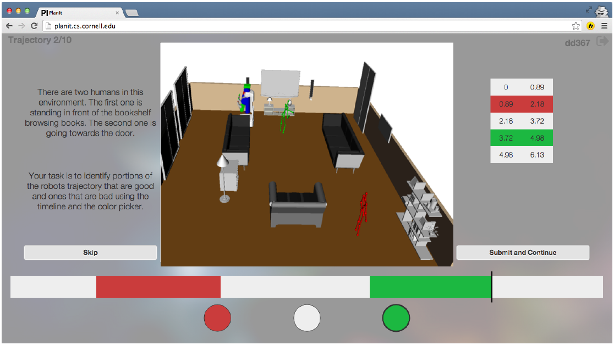
PlanIt: A crowdsourcing approach
Average feedback time < 15sec
Users do not reveal the reason for dislike/like
Latent variable: parameters learned using EM
http://planit.cs.cornell.edu

Slide 27
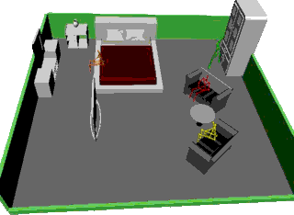
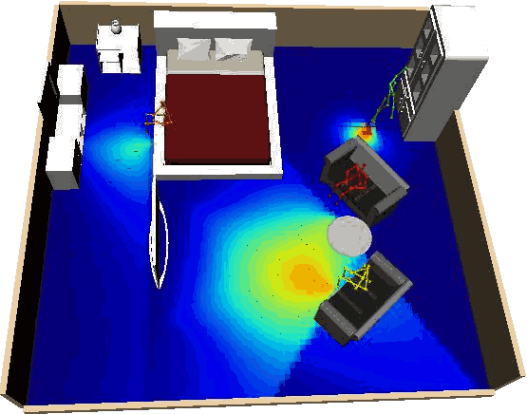
Learned concepts from PlanIt
118 environments for manipulation and navigation tasks
Environment with various activities
Perceived by the robot:
Spatial distribution of activities

Slide 28
PlanIt Demo
http://planit.cs.cornell.edu

Slide 29
Co-active Learning Setting
$s\left(x , y;w\right)$ =
$$w^{T}φ(x,y)$$
$s^{∗}\left(x , y\right)$ =
$$w^{∗T}φ(x,y)$$
Robot
User
Goal: Learn user preferences
Learn from sub-optimal feedback
Jain et al. NIPS 2013

Slide 30
Learning Plans with Context from Human Signals
Planning
Assembly lines, homes, context-rich environments
Learning Algorithms
SVM, IRL, Graphical models,
No-regret algorithms
Human Signals
Expert’s demonstrations,
Co-active feedback, Language
Notes:
As planning problems becomes complex we relay on data driven leanring approaches. We receive human signals and have leanring algorithms.

Slide 31
Summary
Cornell Robot Learning Lab
Notes:
As planning problems becomes complex we relay on data driven leanring approaches. We receive human signals and have leanring algorithms.

Slide 32


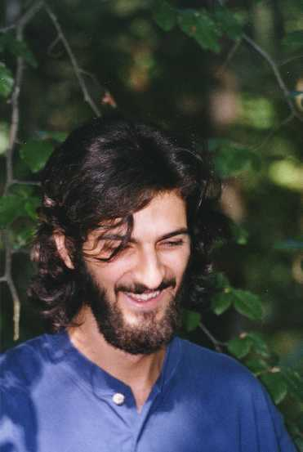



Invited Speakers
Pieter Abbeel UCB
Alan Fern
OSU
Manuel Lopes
INRIA
Maja Mataric
USC
Julie Shah
MIT
Andrea Thomaz
GaTech

Slide 33
Learning Plans with Context from Human Signals
Drew Bagnell
CMU
Ashesh Jain
Cornell University
Jan Peters
TU Darmstadt
Ashutosh Saxena
Cornell University

Slide 34
Workshop summary
Notes:
As planning problems becomes complex we relay on data driven leanring approaches. We receive human signals and have leanring algorithms.

Slide 35
Food for thought!
Intuitive teaching methods
Interactive learning
….
Learning from real users
Different from experts (not roboticists)
Scaling human signals
Depends on the application
Crowdsourcing methods (PlanIt, TellMeDave)

Slide 36
Invited Speakers – Thank You
Pieter Abbeel UCB
Alan Fern
OSU
Manuel Lopes
INRIA
Maja Mataric
USC
Julie Shah
MIT
Andrea Thomaz
GaTech

Slide 37
Co-organizers – Thank You
Drew Bagnell
CMU
Jan Peters
TU Darmstadt
Ashutosh Saxena
Cornell University

Slide 38
Panel discussion
What's the most pressing problem in practical robot planning?
Assembly, personal, assistive robots
What do you view as the biggest successes thus far in learning to plan?
Assembly, personal, assistive robots

